Slide 1
Impact of Using Raw Versus Uniform T Scores in Minnesota Multiphasic Personality
Inventory-2 Restructured Form Descriptive and Inferential Research
Jayme Luna and Katrina Conen
Supervised by: Danielle Burchett
California State University, Monterey Bay
In collaboration with: Anthony M. Tarescavage Kent State University & David M. Glassmire Patton State Hospital

Slide 2

Research on Standardized Tests
https://cdn.theconversation.com/files/57399/width926/q53gbx33-1409053589.jpg

Slide 3
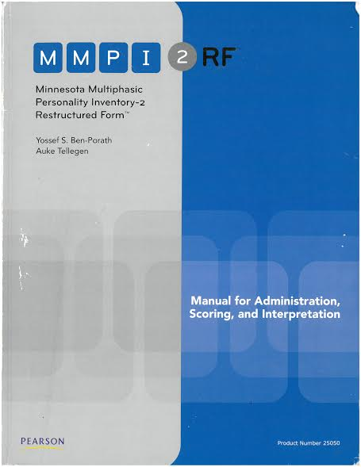
MMPI-2-RF
338-item self-report measure
Assess personality & psychopathology dysfunction
Used in clinical and other settings
(Tellegen & Ben-Porath, 2008/2011)

Slide 4
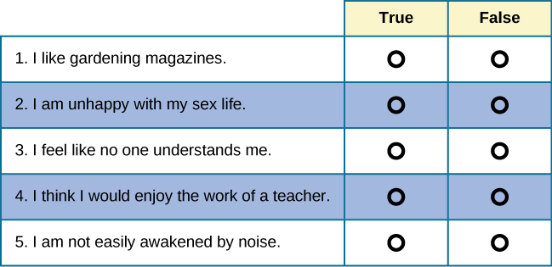
Raw Scores
Responses on subsets of items are used to calculate scores on scales
Number of items answered on a scale in a keyed direction
https://s3-us-west-2.amazonaws.com/courses-images-archive-read-only/wp-content/uploads/sites/902/2015/02/23225029/CNX_Psych_11_09_MMPI.jpg

Slide 5
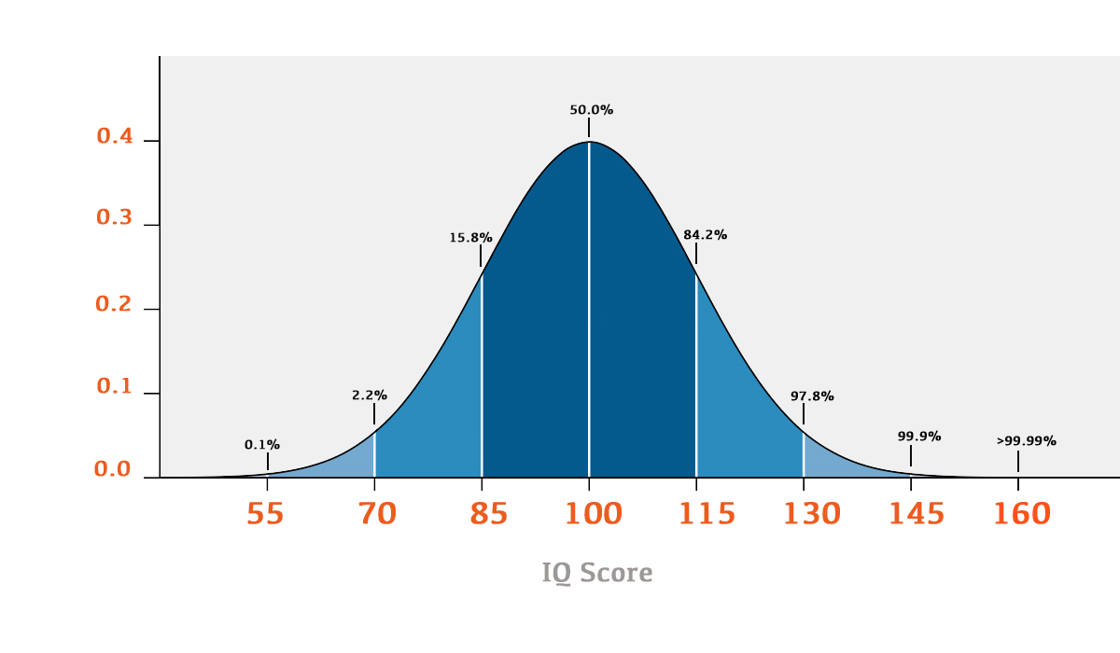
Standardized Scores
Aid interpreting results
Start with raw scores
Example IQ tests (M = 100 / SD = 15)
Comparison of differences
http://www.rutherfordiq.com/static/images/distributioncurve.png

Slide 6
Uniform T Scores
Alternative standardized score
Specific to the MMPI
M = 50 / SD = 10
Positively skewed because symptom-based items are rarely endorsed by most people
(Tellegen & Ben-Porath, 1992; Ben-Porath, 2012)

Slide 7
Uniform T Scores
“Smoothing” process
  Same distributional shape
  Same severity level
Comparable to general population
(Tellegen & Ben-Porath, 1992; Ben-Porath, 2012)

Slide 8
Anxiety
Depression
Psychotic
65T
Uniform T
30
50
70
120T

Slide 9


Current Study
Importance
  Researchers use raw scores
  Clinicians use Uniform T scores
  A head-to-head comparison of raw and Uniform T has not been conducted for the MMPI-2-RF
IRB approval was obtained
We interpreted results and read relative literature
http://therapy2thrive.com/wp-content/uploads/2016/01/Therapist-Cartoon.jpg
http://clipart-library.com/images/8cAbqdnki.jpg

Slide 10
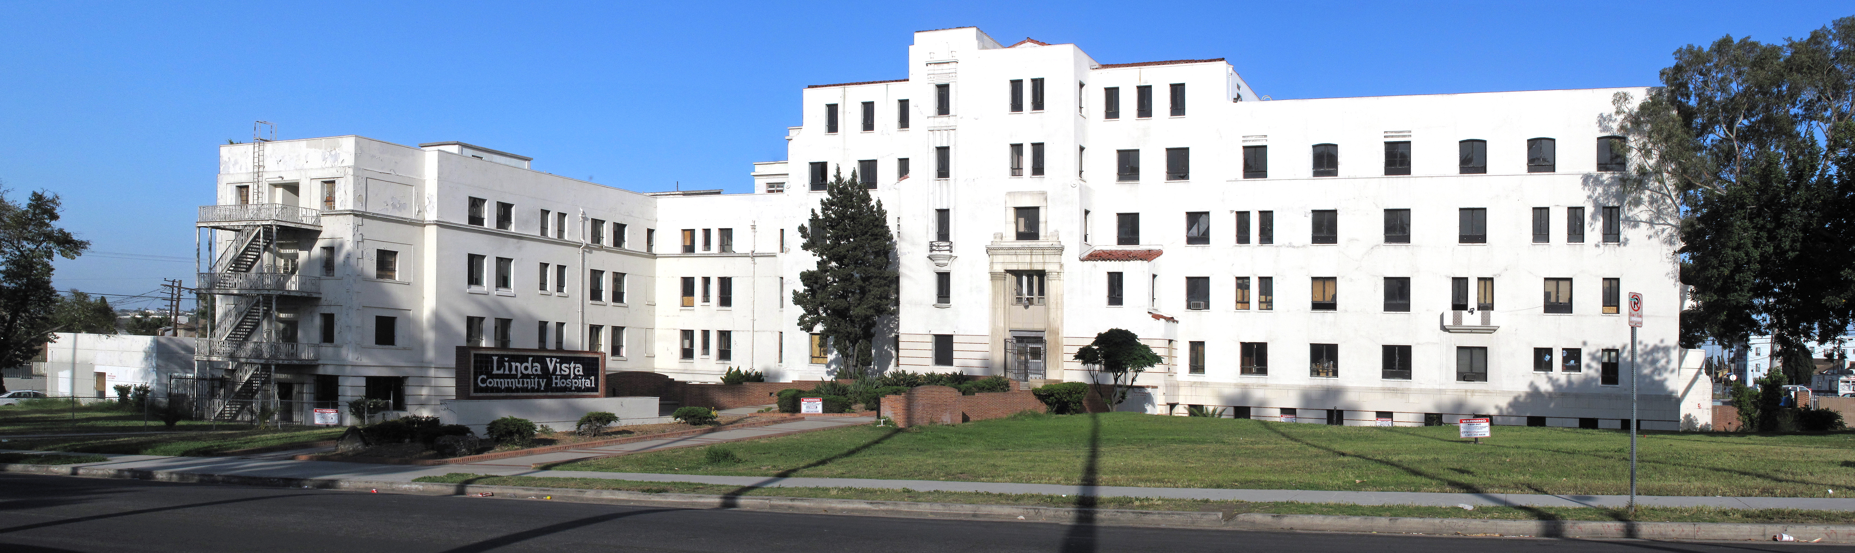
Participants
764 psychiatric inpatients at a forensic state hospital
  Committed for:
    Incompetency to stand trial
    Insanity at time of offense
    Transferred from a prison for psychiatric treatment
https://www.google.com/search?q=linda+vista+community+hospital&espv=2&source=lnms&tbm=isch&sa=X&ved=0ahUKEwjn0oOI2JLTAhUDzWMKHeudBGsQ_AUIBygC&biw=1366&bih=638#imgrc=k0x80M0rnb--CM:

Slide 11

Participants
Most patients living with severe psychological illnesses
  Schizophrenia
  Bipolar Disorder
  Major Depressive Disorder
  Substance Abuse
  Antisocial Personality Disorder
https://img.clipartfest.com/1a13fbb1a2a774b4d94f3440b4a1f20f_download-this-image-as-free-clipart-stick-figure-people-in-a-group_600-474.png

Slide 12
Internalizing, Thought, and Externalizing Disorder Scales
Internalizing Disorder Scales | Thought Disorder Scales | Externalizing Disorder Scales
Emotional/Internalizing Dysfunction (EID) | Thought Dysfunction (THD) | Behavioral/Externalizing Dysfunction (BXD)
Demoralization (RCd) | Ideas of Persecution (RC6) | Antisocial Behavior (RC4)
Low Positive Emotions (RC2) | Aberrant Experiences (RC8) | Hypomanic Activation (RC9)
Dysfunctional Negative Emotions (RC7)
(Ben-Porath & Tellegen, 2008; Romero, Toorabally, Burchett, Tarescavage, & Glassmire 2016)

Slide 13
Hypothesis: Skewness and Kurtosis
No Skew
Skewness = 0
We predicted Uniform T scores would have a less normal distribution
Leptokurtic
Kurtosis = 1
Some Positive Skew
Skewness = 1
Mesokurtic
Kurtosis = 0
Platykurtic
Kurtosis = -1
Notable Positive Skew
Skewness = 2
https://brownmath.com/stat/shape.htm

Slide 14

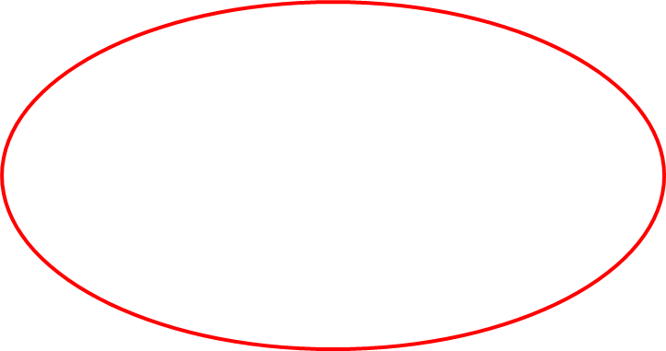
Hypothesis: Scale Intercorrelations and Point Biserial Correlations
No Association
r = 0.00
r_{pb} = 0.00
We predicted raw scores would have slightly stronger scale intercorrelations
We predicted raw scores would have somewhat stronger correlations with relevant psychiatric diagnostic criteria
0
1
Modest Positive Association
r = 0.25
r_{pb} = 0.20
0
Strong Positive Association
r = 0.70
r_{pb} = 0.60
0
1

Slide 15
Results

Slide 16
Table 2. MMPI-2-RF Scale Raw and Uniform T Score Intercorrelations (n = 764)
Raw Score (below) / Uniform T Score (Right) | EID | RCd | RC2 | RC7 | THD | RC6 | RC8 | BXD | RC4 | RC9
EID Emotional/Internalizing Dysfunction | .99* | .91* | .70* | .75* | .45* | .44* | .46* | .33* | .42* | .31*
RCd Demoralization | .92* | .99* | .53* | .74* | .49* | .46* | .52* | .39* | .48* | .39*
RC2 Low Positive Emotions | .70* | .55* | 1.00* | .25* | .14* | .17* | .12* | -0.01 | .15* | -.19*
RC7 Dysfunctional Negative Emotions | .75* | .74* | .25* | 1.00* | .59* | .54* | .62* | .48* | .47* | .62*
THD Thought Dysfunction | .42* | .46* | .13* | .58* | .98* | .85* | .87* | .31* | .29* | .51*
RC6 Ideas of Persecution | .42* | .44* | .18* | .52* | .88* | .97* | .62* | .24* | .23* | .43*
RC8 Aberrant Experiences | .45* | .51* | .12* | .63* | .87* | .65* | .99* | .41* | .38* | .57*
BXD Behavioral / Externalizing Dysfunction | .32* | .38* | -0.01 | .48* | .30* | .23* | .40* | 1.00* | .88* | .70*
RC4 Antisocial Behavior | .42* | .47* | .15* | .47* | .28* | .22* | .37* | .88* | 1.00* | .49*
RC9 Hypomanic Activation | .30* | .38* | -.18* | .61* | .49* | .42* | .56* | .70* | .49* | .99*
Note. *p < .01. Raw score intercorrelations are presented below the diagonal. Uniform T score intercorrelations are presented above the diagonal. Raw/T intercorrelations are presented on the diagonal. Shading indicates correlations in the same domain of psychopathology. Rounded truncated Uniform T scores are examined.

Slide 17
 | M | SD | Min. | Max. | Skewness | Kurtosis | r_{pb} with Dx.
INTERNALIZING DYSFUNCTION SCALES
EID Emotional/Internalizing Dysfunction (raw) | 10.33 | 8.02 | 0 | 38 | 1.03 | 0.46 | .19
EID Emotional/Internalizing Dysfunction (T) | 49.84 | 11.93 | 30T | 89T | 0.71 | 0.16 | .18
RCd Demoralization (raw) | 5.83 | 5.72 | 0 | 23 | 1.00 | 0.00 | .17
RCd Demoralization (T) | 52.08 | 11.48 | 37 | 85 | 0.62 | -0.29 | .17
RC2 Low Positive Emotions (raw) | 4.35 | 3.28 | 0 | 17 | 0.98 | 0.81 | .11
RC2 Low Positive Emotions (T) | 51.11 | 12.61 | 34 | 99 | 0.91 | 0.68 | .11
RC7 Dysfunctional Negative Emotions (raw) | 5.40 | 4.81 | 0 | 21 | 0.92 | 0.07 | .18
RC7 Dysfunctional Negative Emotions (T) | 48.05 | 11.04 | 34 | 86 | 0.88 | 0.41 | .18
THOUGHT DYSFUNCTION SCALES
THD Thought Dysfunction (raw) | 3.53 | 3.83 | 0 | 20 | 1.52 | 0.09 | .07
THD Thought Dysfunction (T) | 56.51 | 14.72 | 39T | 100T | 0.95 | 0.09 | .08
RC6 Ideas of Persecution (raw) | 2.48 | 2.89 | 0 | 16 | 1.46 | 1.80 | .03
RC6 Ideas of Persecution (T) | 60.39 | 15.64 | 43 | 100 | 0.71 | -0.20 | .04
RC8 Aberrant Experiences (raw) | 2.96 | 3.02 | 0 | 15 | 1.28 | 1.30 | .06
RC8 Aberrant Experiences (T) | 53.82 | 12.21 | 39 | 96 | 0.75 | 0.18 | .07
EXTERNALIZING DYSFUNCTION SCALES
BXD Behavioral / Externalizing Dysfunction (raw) | 8.20 | 4.35 | 0 | 22 | 0.38 | -0.38 | .20
BXD Behavioral/Externalizing Dysfunction (T) | 55.69 | 11.06 | 32T | 92T | 0.38 | -0.20 | .21
RC4 Antisocial Behavior (raw) | 7.78 | 4.29 | 0 | 20 | 0.37 | -0.53 | .21
RC4 Antisocial Behavior (T) | 58.95 | 11.94 | 34 | 93 | 0.34 | -0.42 | .21
RC9 Hypomanic Activation (raw) | 9.79 | 5.37 | 0 | 27 | 0.48 | -0.43 | .06
RC9 Hypomanic Activation (T) | 46.55 | 10.79 | 25 | 88 | 0.75 | 0.52 | .06

Slide 18
 | M | SD | Min. | Max. | Skewness | Kurtosis | r_{pb} with Dx.
INTERNALIZING DYSFUNCTION SCALES
EID Emotional/Internalizing Dysfunction (raw) | 10.33 | 8.02 | 0 | 38 | 1.03 | 0.46 | .19
EID Emotional/Internalizing Dysfunction (T) | 49.84 | 11.93 | 30T | 89T | 0.71 | 0.16 | .18
RCd Demoralization (raw) | 5.83 | 5.72 | 0 | 23 | 1.00 | 0.00 | .17
RCd Demoralization (T) | 52.08 | 11.48 | 37 | 85 | 0.62 | -0.29 | .17
RC2 Low Positive Emotions (raw) | 4.35 | 3.28 | 0 | 17 | 0.98 | 0.81 | .11
RC2 Low Positive Emotions (T) | 51.11 | 12.61 | 34 | 99 | 0.91 | 0.68 | .11
RC7 Dysfunctional Negative Emotions (raw) | 5.40 | 4.81 | 0 | 21 | 0.92 | 0.07 | .18
RC7 Dysfunctional Negative Emotions (T) | 48.05 | 11.04 | 34 | 86 | 0.88 | 0.41 | .18
THOUGHT DYSFUNCTION SCALES
THD Thought Dysfunction (raw) | 3.53 | 3.83 | 0 | 20 | 1.52 | 0.09 | .07
THD Thought Dysfunction (T) | 56.51 | 14.72 | 39T | 100T | 0.95 | 0.09 | .08
RC6 Ideas of Persecution (raw) | 2.48 | 2.89 | 0 | 16 | 1.46 | 1.80 | .03
RC6 Ideas of Persecution (T) | 60.39 | 15.64 | 43 | 100 | 0.71 | -0.20 | .04
RC8 Aberrant Experiences (raw) | 2.96 | 3.02 | 0 | 15 | 1.28 | 1.30 | .06
RC8 Aberrant Experiences (T) | 53.82 | 12.21 | 39 | 96 | 0.75 | 0.18 | .07
EXTERNALIZING DYSFUNCTION SCALES
BXD Behavioral / Externalizing Dysfunction (raw) | 8.20 | 4.35 | 0 | 22 | 0.38 | -0.38 | .20
BXD Behavioral/Externalizing Dysfunction (T) | 55.69 | 11.06 | 32T | 92T | 0.38 | -0.20 | .21
RC4 Antisocial Behavior (raw) | 7.78 | 4.29 | 0 | 20 | 0.37 | -0.53 | .21
RC4 Antisocial Behavior (T) | 58.95 | 11.94 | 34 | 93 | 0.34 | -0.42 | .21
RC9 Hypomanic Activation (raw) | 9.79 | 5.37 | 0 | 27 | 0.48 | -0.43 | .06
RC9 Hypomanic Activation (T) | 46.55 | 10.79 | 25 | 88 | 0.75 | 0.52 | .06

Slide 19
 | M | SD | Min. | Max. | Skewness | Kurtosis | r_{pb} with Dx.
INTERNALIZING DYSFUNCTION SCALES
EID Emotional/Internalizing Dysfunction (raw) | 10.33 | 8.02 | 0 | 38 | 1.03 | 0.46 | .19
EID Emotional/Internalizing Dysfunction (T) | 49.84 | 11.93 | 30T | 89T | 0.71 | 0.16 | .18
RCd Demoralization (raw) | 5.83 | 5.72 | 0 | 23 | 1.00 | 0.00 | .17
RCd Demoralization (T) | 52.08 | 11.48 | 37 | 85 | 0.62 | -0.29 | .17
RC2 Low Positive Emotions (raw) | 4.35 | 3.28 | 0 | 17 | 0.98 | 0.81 | .11
RC2 Low Positive Emotions (T) | 51.11 | 12.61 | 34 | 99 | 0.91 | 0.68 | .11
RC7 Dysfunctional Negative Emotions (raw) | 5.40 | 4.81 | 0 | 21 | 0.92 | 0.07 | .18
RC7 Dysfunctional Negative Emotions (T) | 48.05 | 11.04 | 34 | 86 | 0.88 | 0.41 | .18
THOUGHT DYSFUNCTION SCALES
THD Thought Dysfunction (raw) | 3.53 | 3.83 | 0 | 20 | 1.52 | 0.09 | .07
THD Thought Dysfunction (T) | 56.51 | 14.72 | 39T | 100T | 0.95 | 0.09 | .08
RC6 Ideas of Persecution (raw) | 2.48 | 2.89 | 0 | 16 | 1.46 | 1.80 | .03
RC6 Ideas of Persecution (T) | 60.39 | 15.64 | 43 | 100 | 0.71 | -0.20 | .04
RC8 Aberrant Experiences (raw) | 2.96 | 3.02 | 0 | 15 | 1.28 | 1.30 | .06
RC8 Aberrant Experiences (T) | 53.82 | 12.21 | 39 | 96 | 0.75 | 0.18 | .07
EXTERNALIZING DYSFUNCTION SCALES
BXD Behavioral / Externalizing Dysfunction (raw) | 8.20 | 4.35 | 0 | 22 | 0.38 | -0.38 | .20
BXD Behavioral/Externalizing Dysfunction (T) | 55.69 | 11.06 | 32T | 92T | 0.38 | -0.20 | .21
RC4 Antisocial Behavior (raw) | 7.78 | 4.29 | 0 | 20 | 0.37 | -0.53 | .21
RC4 Antisocial Behavior (T) | 58.95 | 11.94 | 34 | 93 | 0.34 | -0.42 | .21
RC9 Hypomanic Activation (raw) | 9.79 | 5.37 | 0 | 27 | 0.48 | -0.43 | .06
RC9 Hypomanic Activation (T) | 46.55 | 10.79 | 25 | 88 | 0.75 | 0.52 | .06

Slide 20
Table 2. MMPI-2-RF Scale Raw and Uniform T Score Intercorrelations (n = 764)
Raw Score (below) / Uniform T Score (Right) | EID | RCd | RC2 | RC7 | THD | RC6 | RC8 | BXD | RC4 | RC9
EID Emotional/Internalizing Dysfunction | .99* | .91* | .70* | .75* | .45* | .44* | .46* | .33* | .42* | .31*
RCd Demoralization | .92* | .99* | .53* | .74* | .49* | .46* | .52* | .39* | .48* | .39*
RC2 Low Positive Emotions | .70* | .55* | 1.00* | .25* | .14* | .17* | .12* | -0.01 | .15* | -.19*
RC7 Dysfunctional Negative Emotions | .75* | .74* | .25* | 1.00* | .59* | .54* | .62* | .48* | .47* | .62*
THD Thought Dysfunction | .42* | .46* | .13* | .58* | .98* | .85* | .87* | .31* | .29* | .51*
RC6 Ideas of Persecution | .42* | .44* | .18* | .52* | .88* | .97* | .62* | .24* | .23* | .43*
RC8 Aberrant Experiences | .45* | .51* | .12* | .63* | .87* | .65* | .99* | .41* | .38* | .57*
BXD Behavioral / Externalizing Dysfunction | .32* | .38* | -0.01 | .48* | .30* | .23* | .40* | 1.00* | .88* | .70*
RC4 Antisocial Behavior | .42* | .47* | .15* | .47* | .28* | .22* | .37* | .88* | 1.00* | .49*
RC9 Hypomanic Activation | .30* | .38* | -.18* | .61* | .49* | .42* | .56* | .70* | .49* | .99*
Note. *p < .01. Raw score intercorrelations are presented below the diagonal. Uniform T score intercorrelations are presented above the diagonal. Raw/T intercorrelations are presented on the diagonal. Shading indicates correlations in the same domain of psychopathology. Rounded truncated Uniform T scores are examined.

Slide 21
Table 2. MMPI-2-RF Scale Raw and Uniform T Score Intercorrelations (n = 764)
Raw Score (below) / Uniform T Score (Right) | EID | RCd | RC2 | RC7 | THD | RC6 | RC8 | BXD | RC4 | RC9
EID Emotional/Internalizing Dysfunction | .99* | .91* | .70* | .75*
RCd Demoralization | .92* | .99* | .53* | .74*
RC2 Low Positive Emotions | .70* | .55* | 1.00* | .25*
RC7 Dysfunctional Negative Emotions | .75* | .74* | .25* | 1.00*
THD Thought Dysfunction |  |  |  |  | .98* | .85* | .87*
RC6 Ideas of Persecution |  |  |  |  | .88* | .97* | .62*
RC8 Aberrant Experiences |  |  |  |  | .87* | .65* | .99*
BXD Behavioral / Externalizing Dysfunction |  |  |  |  |  |  |  | 1.00* | .88* | .70*
RC4 Antisocial Behavior |  |  |  |  |  |  |  | .88* | 1.00* | .49*
RC9 Hypomanic Activation |  |  |  |  |  |  |  | .70* | .49* | .99*
Note. *p < .01. Raw score intercorrelations are presented below the diagonal. Uniform T score intercorrelations are presented above the diagonal. Raw/T intercorrelations are presented on the diagonal. Shading indicates correlations in the same domain of psychopathology. Rounded truncated Uniform T scores are examined.

Slide 22
Discussion
Skewness and kurtosis values higher for raw scores
  Greater non-normality of raw score distributions
  Compared to Uniform T scores
Recommend the use of Uniform T scores
Differences are modest, so the existing research is still applicable

Slide 23

Limitations and Future Studies
Limitations
  Specific population setting
Future Studies
  Replication
    Wider variety of external criteria
https://www.google.com/search?q=future&source=lnms&tbm=isch&sa=X&ved=0ahUKEwi977u22pLTAhVG5GMKHfxjCEAQ_AUICigD&biw=1366&bih=638#tbm=isch&q=the+future+sign&imgrc=a3Ue4Y6BhNd-wM:

Slide 24


Acknowledgments and References
Thank you for making this project possible:
University of Minnesota Press
Dr. Glassmire of Patton State Hospital
Dr. Tarescavage of Kent State University
Dr. Burchett of CSUMB
CSUMB Undergraduate Research Opportunities Center (UROC)
American Psychiatric Association. (2000). Diagnostic and Statistical Manual of Mental Disorders: DSM-IV-TR, Fourth Edition, Text Revision. Washington, DC.
Ben-Porath, Y. S. (2003). Assessing personality and psychopathology with self-report inventories. In J. Graham & J. Naglieri (Eds.), Handbook of psychology, Volume 10: Assessment psychology (pp. 553-577). Hoboken, NJ: John Wiley & Sons, Inc.
Ben-Porath, Y. S. (2012). Interpreting the MMPI-2-RF. Minneapolis: University of Minnesota Press.
Ben-Porath, Y. S., & Tellegen, A. (2008/2011). MMPI-2-RF: Manual for administration, scoring, and interpretation. Minneapolis: University of Minnesota Press.
Graham, J. R. (2012). MMPI-2: Assessing personality and psychopathology (5th ed.). New York: Oxford University Press.
Kreuger, R.F., Caspi, A., Moffitt, T. E., & Silva, P. A. (1998). The structure and stability of common mental disorders (DSM-III-R): A longitudinal-epidemiological study. Journal of Abnormal Psychology, 107(2), 216-227.
Romero, I. E., Toorabally, N., Burchett, D., Tarescavage, A. M., & Glassmire, D. M. (2016). Mapping the MMPI–2–RF substantive scales onto internalizing, externalizing, and thought dysfunction dimensions in a forensic inpatient setting. Journal of Personality Assessment. Advance online publication. DOI: 10.1080/00223891.2016.1223681
Tellegen, A., & Ben-Porath, Y. S. (2008/2011). MMPI-2-RF technical manual. Minneapolis: University of Minnesota Press.
van der Heijden, P.T., Egger, J. M., Rossi, G. P., & Derksen, J. L. (2012). Integrating psychopathology and personality disorders conceptualized by the MMPI-2-RF and the MCMI-III: A structural validity study. Journal of Personality Assessment, 94(4), 345-357.

Slide 25
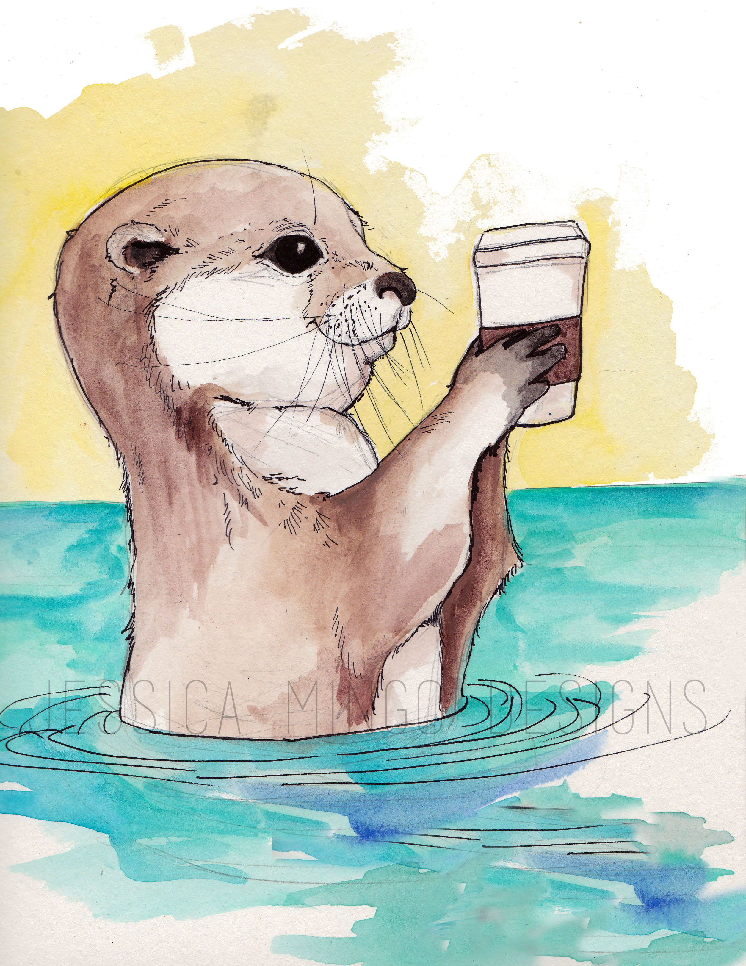
Questions?
Clinical and Forensic Evaluation (CAFE) Lab

